Slide 1
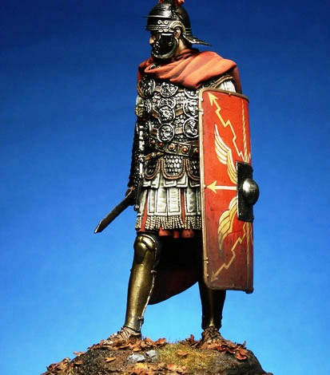
The Whole Armour of God
By: Bro. John Tarver

Slide 2
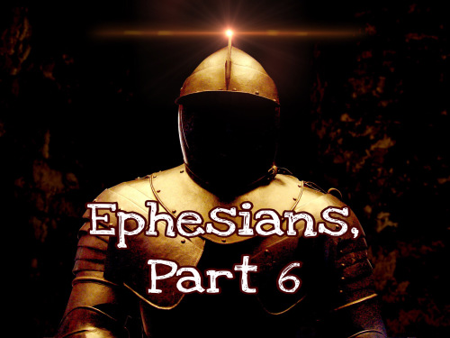
Before describing the Whole Armour of God, How did Paul begin?
“Finally, my brethren, be strong in the Lord, and in the power of his might.” v. 10
“Put on the whole armour of God, that ye may be able to stand against the wiles of the devil.” v. 11
“For we wrestle not against flesh and blood, but against principalities, against powers, against the rulers of the darkness of this world, against spiritual wickedness in high places.” v. 12
“Wherefore take unto you the whole armour of God, that ye may be able to withstand in the evil day, having done all, to stand.” v. 13

Slide 3
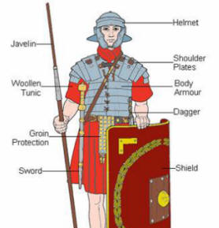
What pieces make up “The Whole Armour of God?”
Belt of Truth
Breastplate of Righteousness
Feet Covered with Gospel of Peace
Shield of Faith
Helmet of God’s Saving Power
Sword of God’s Message

Slide 4

Belt of Truth
“Stand therefore, having your loins girt with truth. (Eph. 6:14)
PURPOSE :
  Wraps around or encircles your waist – holds everything together.
MEANING:
  Because God’s Truth is the only truth, every action we take must come from him. This fact allows us to follow God’s commandments without deviating from the path.
REFERENCE: “And Ye Shall Know the Truth, and the Truth Shall Set You Free.” (John 8:32)

Slide 5
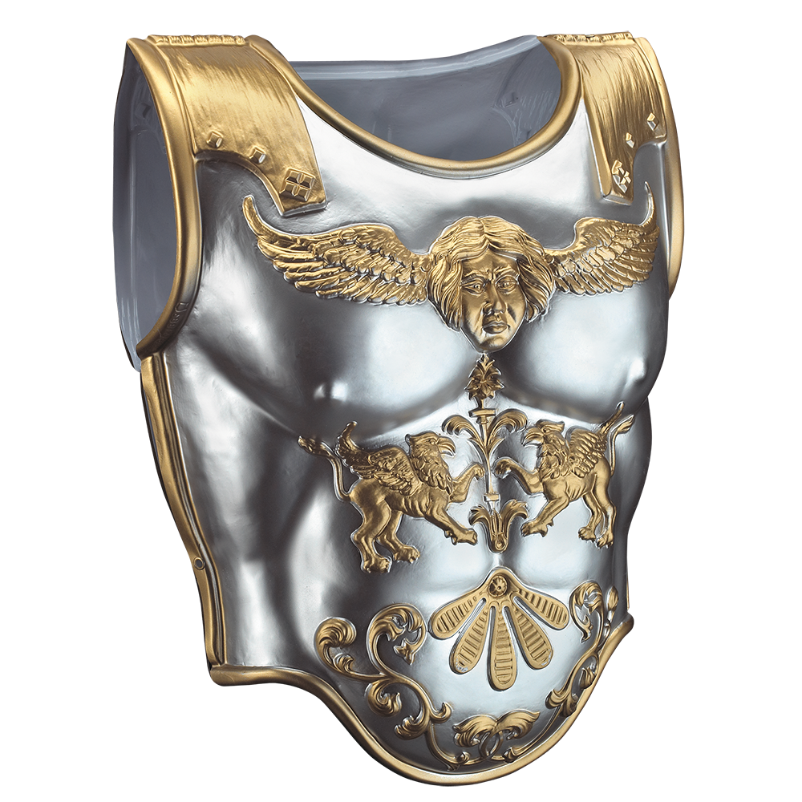
Breastplate of Righteousness
“and having on the breastplate of righteousness.” (Eph. 6:14)
PURPOSE :
  Protects Your Heart & Lungs – Cannot live without them.
MEANING:
  To be righteous means to commit yourself to obeying God’s commandments and to live in a way that is honorable to him.
REFERENCE: “Blessed are they that keep judgment, and he that doeth righteousness at all times.” (Psalm 106:3)

Slide 6
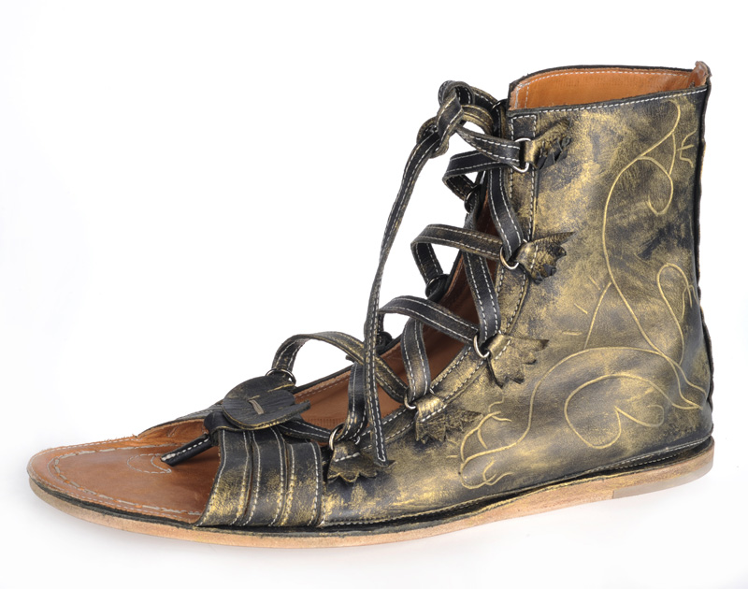
Feet Covered with the Gospel of Peace
“And your feet shod with the preparation of the gospel of peace.” (Eph. 6:15)
PURPOSE :
  Feet are prepared or outfitted to get you from one place to another.
MEANING:
  The word “Gospel” means “Good News” referring to the sacrifice Jesus made for us. The Lord calls us to share this “Good News” with others everywhere we go.
REFERENCE: “And how shall they preach, except they be sent? As it is written, How beautiful are the feet of them that preach the gospel of peace and bring glad tidings of good things.” (Romans 10:15)

Slide 7
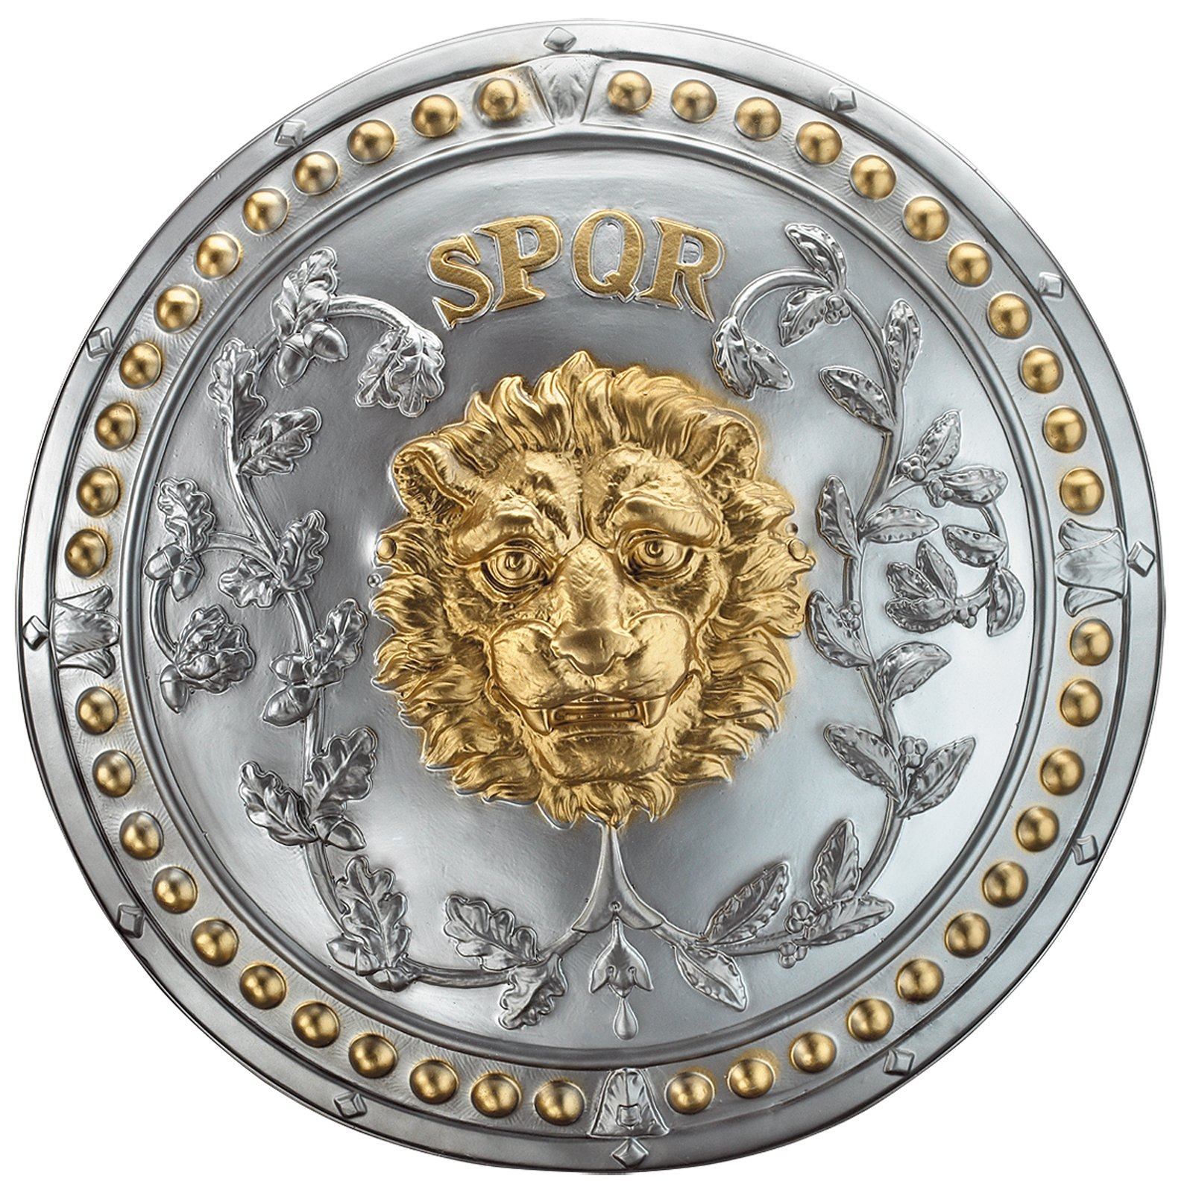
Shield of Faith
“Above all, taking the shield of faith, wherewith ye shall be able to quench all the fiery darts of the wicked.” (Eph. 6:16)
PURPOSE :
  Protect ourselves when attacked.
MEANING:
  Our faith in the Lord can guard us during our daily trials in the same way a shield would during battle.
REFERENCE: “What shall we say to these things? If God be for us, who can be against us?” (Romans 8:31)
This Pho Unknown Author is licensed under CC BY-

Slide 8
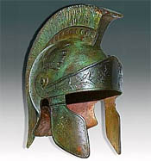
Helmet of God’s Saving Power
“And take the helmet of salvation,” (Eph. 6:17)
PURPOSE :
  Protects your brain if attacked.
MEANING:
  We can find peace when we acknowledge the sacrifice Jesus made for us, and while we encounter the trials of this world, our salvation acts like a helmet in the way that it protects our minds during these trials.
REFERENCE: “ Verily, Verily I say unto you, He that heareth my word, and believeth on him that sent me, hath everlasting life, and shall not come into condemnation, but is passed from death unto life.” (John 5:24)
This Pho Unknown Author is licensed under CC BY-

Slide 9
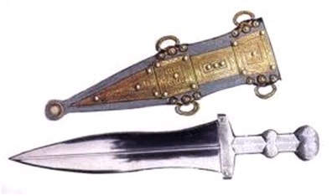
Sword of God’s Message
“And the sword of the spirit, which is the word of God.” (Eph. 6:17)
PURPOSE :
  Weapon used to attack, pierce, or split an attacker.
MEANING:
  Through God’s Word, we can distinguish between right and wrong. As a result, we can strive to live in a way that is free from sin. His Word is the ultimate truth, and we can find confidence in knowing it is our greatest weapon.
REFERENCE: “And saith unto him, if thou be the son of God, cast thyself down: for it is written, He shall give his angels charge concerning thee: and in their hands they shall bear thee up, lest at any time thou dash thy foot against a stone. Jesus said unto him, it is written again, thou shall not tempt the Lord thy God.” (Matthew 4:6-7)
This Pho Unknown Author is licensed under CC BY-

Slide 10
Now That We Know What the Pieces Are…
Do we really need to wear these pieces to actually have “The Whole Armour of God?”
WHY?

Slide 11
How Do We Apply in Our Daily Lives???
It’s not so hard when you are in here surrounded by Sunday School classmates, family & brethren.
What about when times are tough, and you feel like maybe that armor just isn’t holding up the way it should?
Or, when you encounter people in the world, that don’t believe there is such a thing as “Whole Armour of God?”
THEY SAY…

Slide 12
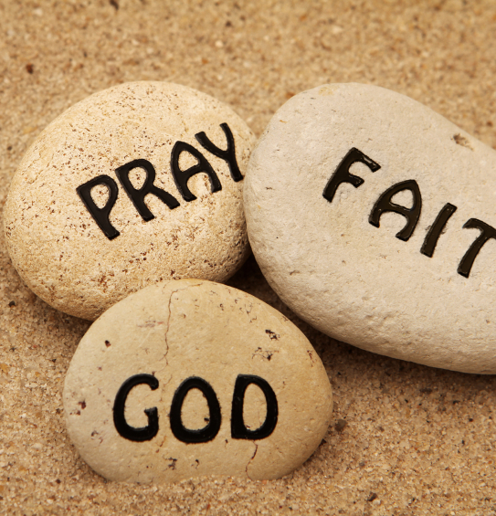
That’s IMPOSSIBLE!!!
How do we overcome the naysayers?
REFERENCE: “But Jesus beheld them, and said unto them, With men this is impossible; but with God all things are possible.” (Matthew 19:26)
God has a way of showing us things all of the time that we think are impossible, WHY?
It is our limited thinking and lack of faith that makes these things seem IMPOSSIBLE.
MAKE SENSE???
If NOT, here is something for the naysayers!

